Slide 1
CAPSTONE PROJECT
EDA on Airbnb Dataset
Team Matter
CONTRIBUTORS:
Amit Padye
Jimmi Kumar
Romaly Das
Shubhankit Sirvaiya

Slide 2

CONTENTS
Objective
Problem Statement
Data Summary
Data Cleaning
Data Analysis, Visualization
& Insights
Challenges Faced
Conclusion

Slide 3
OBJECTIVE
To perform data-driven research and harness insights that will help in realizing trends and increasing the market value and revenue of Airbnb.

Slide 4
PROBLEM STATEMENT
Derive key business insights using Airbnb’s NYC data to boost business decisions that will enhance profitability, market expansion and consumer experience and extract information about traffic and prices in different areas.

Slide 5
DATA SUMMARY
Airbnb dataset : ~49000 observations , 16 features
Numeric features : 8 , Categorical features : 2
Data is specific to New York and nearby suburbs
Data spanning across 2017 through 2019
Important features : host_id ,neighbourhood_group, neighbourhood, room_type, price, minimum_nights, availability_365 , reviews_per_month

Slide 6
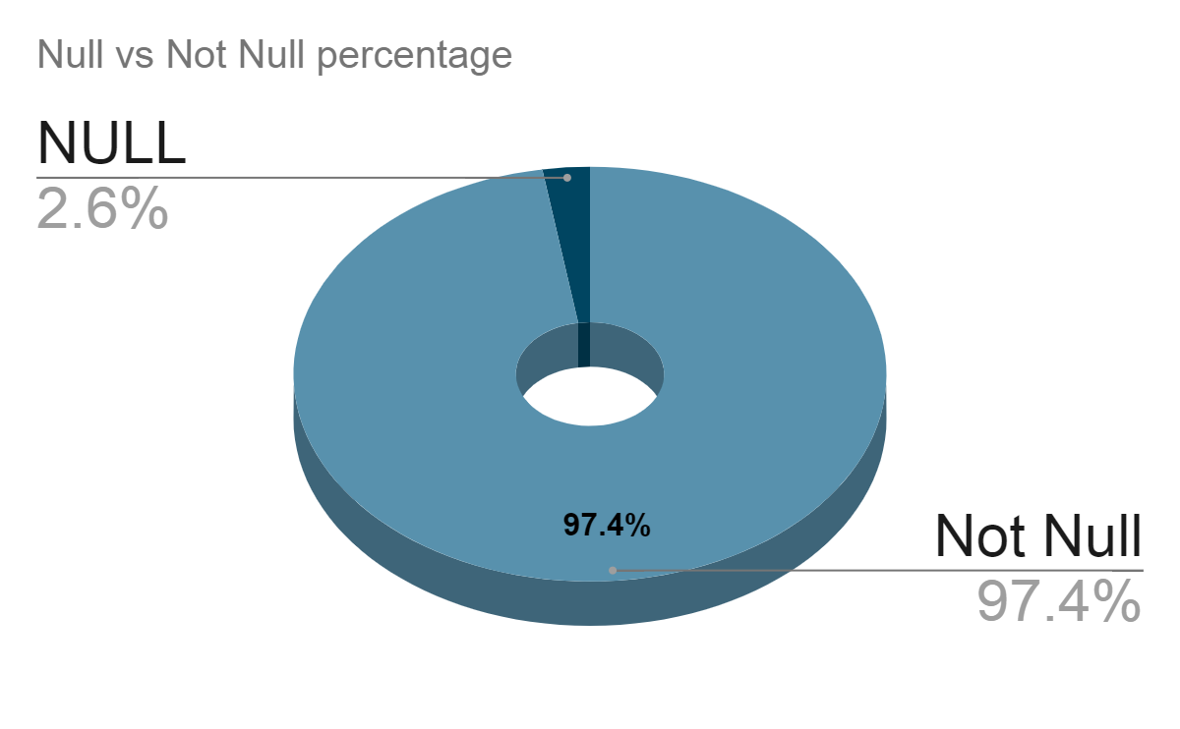
DATA CLEANING
last_review = 10052 null
reviews_per_months = 10052 null
replaced null for reviews_per_month with 0
no changes in last_review
No changes in calculated_host_listing_counts

Slide 7
DATA ANALYSIS
CATEGORICAL FEATURES:
neighbourhood_groups | room_type | minimum_nights_category
Manhattan Brooklyn Queens Staten Island Bronx | Private room Entire home/apt Shared room | 1 day 2-3 days few days 1 week less than a month 1 month more than a month more than half a year less than a year

Slide 8
NUMERICAL FEATURES:
price | This feature represents the price of a particular listing.
minimum_nights | This represents the minimum number of nights spent by a person in a listed Airbnb
availability_365 | Shows availability of the listed Airbnbs in days
host_id | represents a unique id corresponding to a host
latitude, longitude | latitude and longitudinal values of listed Airbnbs
reviews_per_month | This represents total reviews received per month
number_of_reviews | Total number of reviews received till date

Slide 9
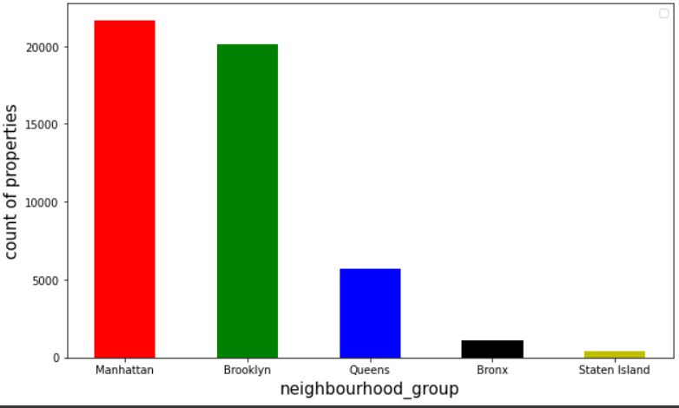
MOST NUMBER OF AIRBNB LISTINGS:
5 unique neighborhood groups
Manhattan and Brooklyn have the most listed properties
Manhattan and Brooklyn belong to New York’s city center

Slide 10
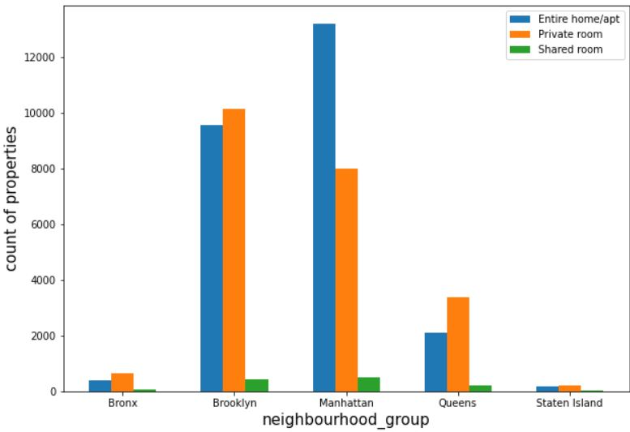
HOST LISTINGS IN AIRBNBS ACCORDING TO ROOM TYPE :
Maximum listing room types: Entire home/apt , private room types
Manhattan and Brooklyn have the most number of listings
Very few listings in Queens, Staten Island and Bronx , but they also follow the same trend

Slide 11
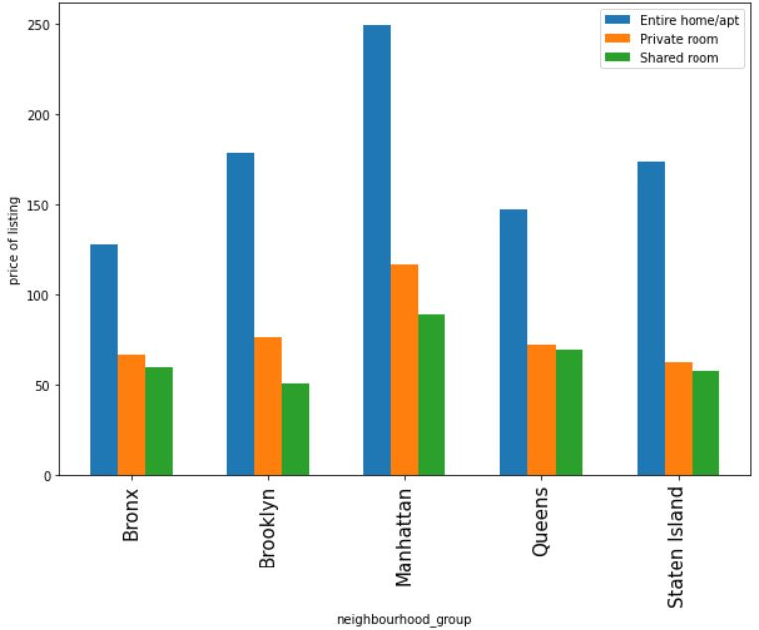
RATES OF AIRBNB LISTINGS ACCORDING TO ROOM TYPES OVER DIFFERENT NEIGHBORHOOD GROUPS:
Rate of Entire home/apt room type is the highest in all the neighborhood groups
Entire home/apt room types have the maximum listed price
This makes sense because an entire home will cost more.

Slide 12
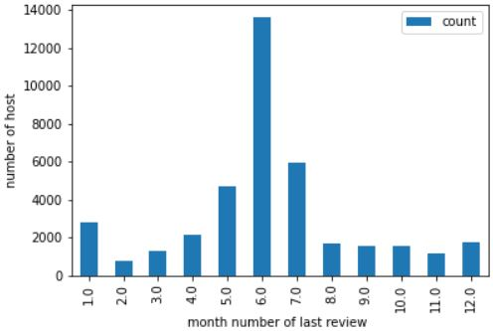
PROPERTIES UTILIZED VS MONTHS IN A YEAR:
Most footfall of customers is during May, June, and July
A spike in June due to summer vacation
Marketing team can propose discounts in off season months to drive consumer engagement, and hence profitability

Slide 13
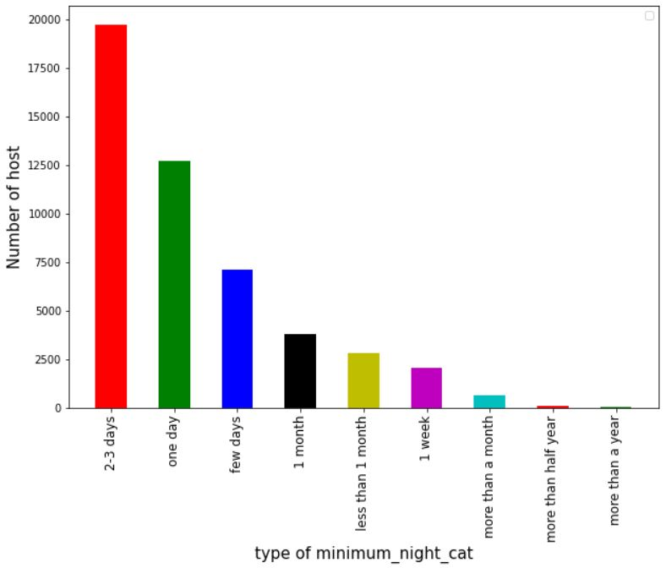
MINIMUM NUMBER OF NIGHTS SPENT BY CUSTOMERS IN AN AIRBNB:
Maximum people book Airbnbs between 1 to 3 days
A reason for this could be tourists and people visiting New York City for business trips.

Slide 14
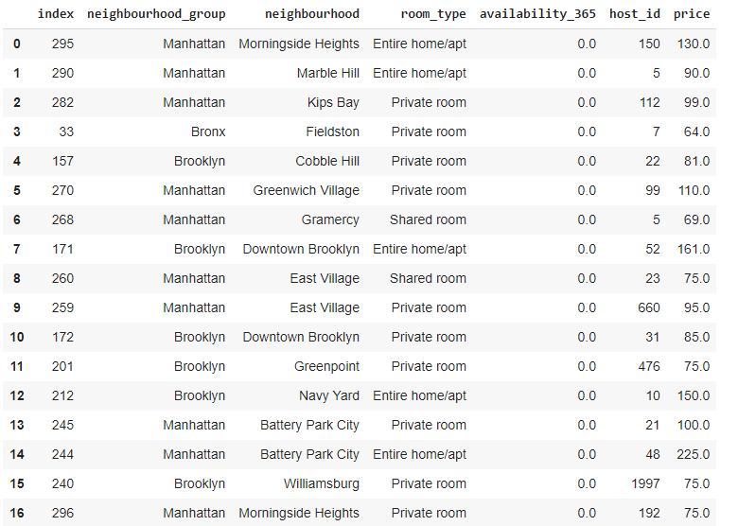
IDENTIFYING GAPS IN SUPPLY AND DEMAND:
Availability is less, implying they have full occupancy
Onboarding of more Airbnbs to increase supply as the demand in these locations surpass the supply
Conversion of shared rooms to other room (refer previous plot )

Slide 15
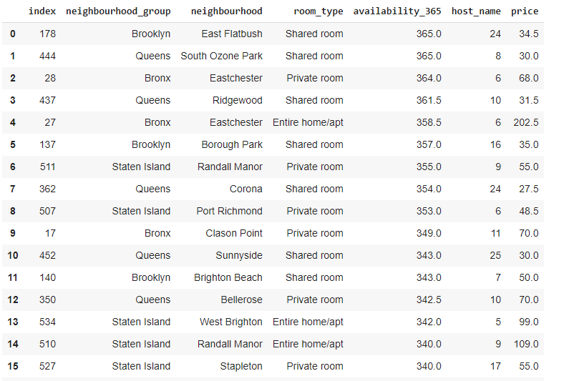

INTRODUCING SOME DISCOUNTS IN LOW DEMAND AREAS:
Occupancy in these locations are relatively less
Discounts can be given to lure customers to these locations

Slide 16

CHALLENGES FACED
Interpretation of all the features and deciding which ones will be helpful in our analysis.
Understanding the dataset and deciding what features we can convert into categorical features, apart from the existing categorical features.
Handling NaN values for last_review feature.
Filtering out important trends and visualizations from the unimportant ones.
Choosing the type of visualization to convey data in a better way

Slide 17
CONCLUSION
Manhattan and Brooklyn are the most crowded suburbs
Listing rates across all the 5 unique neighborhood groups follow a similar trend for all room types. (Refer Slide 10)
Customers prefer to stay in Entire home/apt or private room types
Identifying supply demand gap to boost business decisions
Highest footfall of customers is in the months of May, June and July
Converting shared room type Airbnbs in Manhattan and Brooklyn to other room types will improve revenue generation.
Onboarding more Airbnbs of the Entire home/apt and private room types might help in increasing the revenue.

Slide 18


